Slide 1
PetaBricks: A Language and Compiler based on Autotuning
Saman Amarasinghe
Joint work with
Jason Ansel, Marek Olszewski
Cy Chan, Yee Lok Wong, Maciej Pacula
Una-May O’Reilly and Alan Edelman
Computer Science and Artificial Intelligence Laboratory
Massachusetts Institute of Technology

Slide 2
Outline
The Three Side Stories
Performance and Parallelism with Multicores
Future Proofing Software
Evolution of Programming Languages
Three Observations
PetaBricks
Language
Compiler
Results
Variable Precision
Sibling Rivalry

Slide 3
Today: The Happily Oblivious Average Joe Programmer
Joe is oblivious about the processor
Moore’s law bring Joe performance
Sufficient for Joe’s requirements
Joe has built a solid boundary between Hardware and Software
High level languages abstract away the processors
Ex: Java bytecode is machine independent
This abstraction has provided a lot of freedom for Joe
Parallel Programming is only practiced by a few experts

Slide 4
Moore’s Law
From Hennessy and Patterson, Computer Architecture: A Quantitative Approach, 4th edition, 2006
Itanium 2
1,000,000,000
Itanium
100,000,000
P4
P3
10,000,000
P2
Pentium
Number of Transistors
486
1,000,000
386
286
100,000
8086
10,000
From David Patterson

Slide 5
Uniprocessor Performance (SPECint)
From Hennessy and Patterson, Computer Architecture: A Quantitative Approach, 4th edition, 2006
Itanium 2
1,000,000,000
Itanium
100,000,000
P4
P3
10,000,000
P2
Pentium
Number of Transistors
486
1,000,000
386
286
100,000
8086
10,000
From David Patterson

Slide 6
Squandering of the Moore’s Dividend
10,000x performance gain in 30 years! (~46% per year)
Where did this performance go?
Last decade we concentrated on correctness and programmer productivity
Little to no emphasis on performance
This is reflected in:
Languages
Tools
Research
Education
Software Engineering: Only engineering discipline where performance or efficiency is not a central theme

Slide 7
Matrix Multiply An Example of Unchecked Excesses
Abstraction and Software Engineering
Immutable Types
Dynamic Dispatch
Object Oriented
High Level Languages
Memory Management
Transpose for unit stride
Tile for cache locality
Vectorization
Prefetching
Parallelization
296,260x
12,316x
33,453x
87,042x
2,271x
1,117x
7,514x
522x
220x

Slide 8
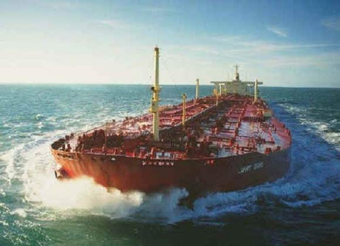
Matrix Multiply An Example of Unchecked Excesses
Typical Software Engineering Approach
In Java
Object oriented
Immutable
Abstract types
No memory optimizations
No parallelization
Good Performance Engineering Approach
In C/Assembly
Memory optimized (blocked)
BLAS libraries
Parallelized (to 4 cores)
296,260x
In Comparison: Lowest to Highest MPG in transportation
14,700x
294,000x

Slide 9
Uniprocessor Performance (SPECint)
From Hennessy and Patterson, Computer Architecture: A Quantitative Approach, 4th edition, 2006
Itanium 2
1,000,000,000
Itanium
100,000,000
P4
P3
10,000,000
P2
Pentium
Number of Transistors
486
1,000,000
386
286
100,000
8086
10,000
From David Patterson

Slide 10
Uniprocessor Performance (SPECint)
From Hennessy and Patterson, Computer Architecture: A Quantitative Approach, 4th edition, 2006
Itanium 2
1,000,000,000
Itanium
100,000,000
P4
P3
10,000,000
P2
Pentium
Number of Transistors
486
1,000,000
386
286
100,000
8086
10,000
From David Patterson

Slide 11
Performance and Parallelism
No more automatic performance gains
Performance has to come from somewhere else
Better languages
Disciplined programming
Performance engineering
Plus…
Parallelism
Moore’s low morphed from providing performance to providing parallelism
But…Parallelism IS performance

Slide 12
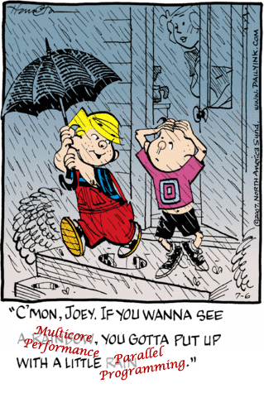
Joe the Parallel Programmer
Moore’s law is not bringing anymore performance gains
If Joe needs performance he has to deal with multicores
Joe has to deal with performance
Joe has to deal with parallelism
Joe

Slide 13
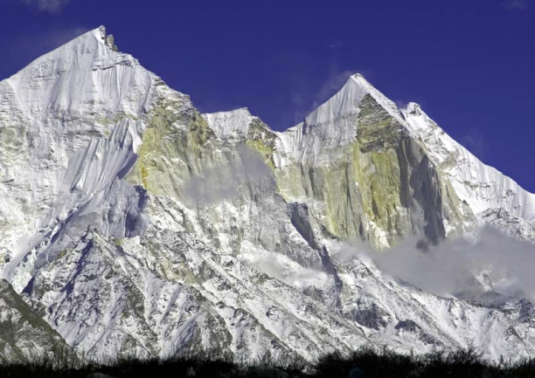
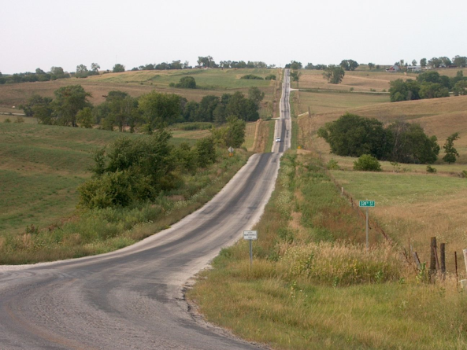
Can Joe Handle This?
Current Trajectory
Programmer handles parallelism and performance turning
Today
Programmer is oblivious to performance.
Better Trajectory
Programmer handles concurrency. Compiler finds best parallel mapping and optimize for performance

Slide 14
Conquering the Multicore Menace
Parallelism Extraction
The world is parallel, but most computer science is based in sequential thinking
Parallel Languages
Natural way to describe the maximal concurrency in the problem
Parallel Thinking
Theory, Algorithms, Data Structures → Education
Parallelism Management
Mapping algorithmic parallelism to a given architecture
Find the best performance possible

Slide 15
Outline
The Three Side Stories
Performance and Parallelism with Multicores
Future Proofing Software
Evolution of Programming Languages
Three Observations
PetaBricks
Language
Compiler
Results
Variable Precision
Sibling Rivalry

Slide 16
In the mean time…….the experts practicing parallel programming
They needed to get the last ounce of the performance from hardware
They had problems that are too big or too hard
They worked on the biggest newest machines
Porting the software to take advantage of the latest hardware features
Spending years (lifetimes) on a specific kernel

Slide 17
Lifetime of Software >> Hardware
Lifetime of a software application is 30+ years
Lifetime of a computer system is less than 6 years
New hardware every 3 years
Multiple Ports
“Software Quality deteriorates in each port
Huge problem for these expert programmers

Slide 18
Not a problem for Joe
Moore’s law gains were sufficient
Targeted the same machine model from 1070 to now
New reality: changing machine model
Joe is in the same boat with the expert programmers
512
Picochip
PC102
Ambric
AM2045
256
Cisco
CSR-1
128
Intel
Tflops
64
32
# of cores
Raza
XLR
Cavium
Octeon
16
Raw
8
Niagara
Cell
4
Boardcom 1480
Opteron 4P
Program written in 1970 still works
And is much faster today
Xeon MP
PA-8800
Xbox360
2
Power4
Opteron
Tanglewood
PExtreme
Power6
1
4004
8080
8086
286
386
486
Pentium
P2
P3
Itanium
Yonah
8008
P4
Athlon
Itanium 2
1970
1975
1980
1985
1990
1995
2000
2005
20??
Notes:
Lets look at a simplified graph of showing a log scale of the number of cores for some commodity microprocessors versus their date of introduction.
For 35 years, uniprocessor designs dominated the commodity microprocessor market.
But their end has come due to the limited scalability of their global, monolithic structures.
The major cpu vendors have stopped development of uniprocessor designs.
In the last 5 years, commodity processor designers have turned to multicore designs to continue performance scalability.
From 2 cores up to hundreds of cores.

Slide 19
Future Proofing Software
No single machine model anymore
Between different processor types
Between different generation within the same family
Programs need to be written-once and use anywhere, anytime
Java did it for portability
We need to do it for performance

Slide 20
Languages and Future Proofing
A lot now
Expose the architectural details
Good performance now
In a local minima
Will be obsolete soon
Heroic effort needed to get out
Ex: MPI
A little forever
Hide the architectural details
Good solutions not visible
Mediocre performance
But will work forever
Ex: HPF
To be an effective language that can future-proof programs
Restrict the choices when a property is hard to automate or constant across architectures of current and future → expose to the user
Features that are automatable and variable → hide from the user

Slide 21
Outline
The Three Side Stories
Performance and Parallelism with Multicores
Future Proofing Software
Evolution of Programming Languages
Three Observations
PetaBricks
Language
Compiler
Results
Variable Precision
Sibling Rivalry

Slide 22
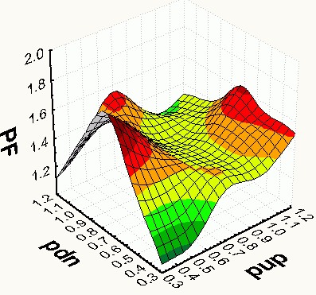
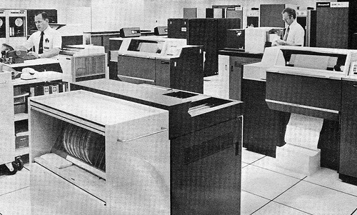
Ancient Days…
Computers had limited power
Compiling was a daunting task
Languages helped by limiting choice
Overconstraint programming languages that express only a single choice of:
Algorithm
Iteration order
Data layout
Parallelism strategy

Slide 23
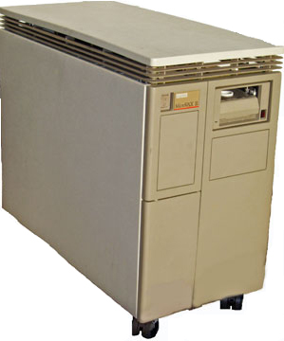
…as we progressed….
Computers got faster
More cycles available to the compiler
Wanted to optimize the programs, to make them run better and faster

Slide 24
…and we ended up at
Computers are extremely powerful
Compilers want to do a lot
But…the same old overconstraint languages
They don’t provide too many choices
Heroic analysis to rediscover some of the choices
Data dependence analysis
Data flow analysis
Alias analysis
Shape analysis
Interprocedural analysis
Loop analysis
Parallelization analysis
Information flow analysis
Escape analysis
…

Slide 25
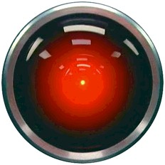
Need to Rethink Languages
Give Compiler a Choice
Express ‘intent’ not ‘a method’
Be as verbose as you can
Muscle outpaces brain
Compute cycles are abundant
Complex logic is too hard

Slide 26
Outline
The Three Side Stories
Performance and Parallelism with Multicores
Future Proofing Software
Evolution of Programming Languages
Three Observations
PetaBricks
Language
Compiler
Results
Variable Precision
Sibling Rivalry

Slide 27
Observation 1: Algorithmic Choice
For many problems there are multiple algorithms
Most cases there is no single winner
An algorithm will be the best performing for a given:
Input size
Amount of parallelism
Communication bandwidth / synchronization cost
Data layout
Data itself (sparse data, convergence criteria etc.)
Multicores exposes many of these to the programmer
Exponential growth of cores (impact of Moore’s law)
Wide variation of memory systems, type of cores etc.
No single algorithm can be the best for all the cases

Slide 28
Observation 2: Natural Parallelism
World is a parallel place
It is natural to many, e.g. mathematicians
∑, sets, simultaneous equations, etc.
It seems that computer scientists have a hard time thinking in parallel
We have unnecessarily imposed sequential ordering on the world
Statements executed in sequence
for i= 1 to n
Recursive decomposition (given f(n) find f(n+1))
This was useful at one time to limit the complexity…. But a big problem in the era of multicores

Slide 29
Observation 3: Autotuning
Good old days → model based optimization
Now
Machines are too complex to accurately model
Compiler passes have many subtle interactions
Thousands of knobs and billions of choices
But…
Computers are cheap
We can do end-to-end execution of multiple runs
Then use machine learning to find the best choice
Algorithmic Complexity
Compiler Complexity
Memory System Complexity
Processor Complexity

Slide 30
Outline
The Three Side Stories
Performance and Parallelism with Multicores
Future Proofing Software
Evolution of Programming Languages
Three Observations
PetaBricks
Language
Compiler
Results
Variable Precision
Sibling Rivalry

Slide 31
PetaBricks Language
transform MatrixMultiply
from A[c,h], B[w,c]
to AB[w,h]
{
// Base case, compute a single element
to(AB.cell(x,y) out)
from(A.row(y) a, B.column(x) b) {
out = dot(a, b);
}
}
Implicitly parallel description
A
y
y
AB
h
AB
h
c
w
B
x
x
c
w

Slide 32
PetaBricks Language
transform MatrixMultiply
from A[c,h], B[w,c]
to AB[w,h]
{
// Base case, compute a single element
to(AB.cell(x,y) out)
from(A.row(y) a, B.column(x) b) {
out = dot(a, b);
}
// Recursively decompose in c
to(AB ab)
from(A.region(0, 0, c/2, h ) a1,
A.region(c/2, 0, c, h ) a2,
B.region(0, 0, w, c/2) b1,
B.region(0, c/2, w, c ) b2) {
ab = MatrixAdd(MatrixMultiply(a1, b1),
MatrixMultiply(a2, b2));
}
Implicitly parallel description
Algorithmic choice
A
b1
AB
a1
a2
AB
B
b2

Slide 33
PetaBricks Language
transform MatrixMultiply
from A[c,h], B[w,c]
to AB[w,h]
{
// Base case, compute a single element
to(AB.cell(x,y) out)
from(A.row(y) a, B.column(x) b) {
out = dot(a, b);
}
// Recursively decompose in c
to(AB ab)
from(A.region(0, 0, c/2, h ) a1,
A.region(c/2, 0, c, h ) a2,
B.region(0, 0, w, c/2) b1,
B.region(0, c/2, w, c ) b2) {
ab = MatrixAdd(MatrixMultiply(a1, b1),
MatrixMultiply(a2, b2));
}
// Recursively decompose in w
to(AB.region(0, 0, w/2, h ) ab1,
AB.region(w/2, 0, w, h ) ab2)
from( A a,
B.region(0, 0, w/2, c ) b1,
B.region(w/2, 0, w, c ) b2) {
ab1 = MatrixMultiply(a, b1);
ab2 = MatrixMultiply(a, b2);
}
a
AB
ab1
AB
ab2
b1
B
b2

Slide 34
PetaBricks Language
transform MatrixMultiply
from A[c,h], B[w,c]
to AB[w,h]
{
// Base case, compute a single element
to(AB.cell(x,y) out)
from(A.row(y) a, B.column(x) b) {
out = dot(a, b);
}
// Recursively decompose in c
to(AB ab)
from(A.region(0, 0, c/2, h ) a1,
A.region(c/2, 0, c, h ) a2,
B.region(0, 0, w, c/2) b1,
B.region(0, c/2, w, c ) b2) {
ab = MatrixAdd(MatrixMultiply(a1, b1),
MatrixMultiply(a2, b2));
}
// Recursively decompose in w
to(AB.region(0, 0, w/2, h ) ab1,
AB.region(w/2, 0, w, h ) ab2)
from( A a,
B.region(0, 0, w/2, c ) b1,
B.region(w/2, 0, w, c ) b2) {
ab1 = MatrixMultiply(a, b1);
ab2 = MatrixMultiply(a, b2);
}
// Recursively decompose in h
to(AB.region(0, 0, w, h/2) ab1,
AB.region(0, h/2, w, h ) ab2)
from(A.region(0, 0, c, h/2) a1,
A.region(0, h/2, c, h ) a2,
B b) {
ab1=MatrixMultiply(a1, b);
ab2=MatrixMultiply(a2, b);
}
}

Slide 35
PetaBricks Language
transform Strassen from A11[n,n], A12[n,n], A21[n,n], A22[n,n], B11[n,n], B12[n,n], B21[n,n], B22[n,n] through M1[n,n], M2[n,n], M3[n,n], M4[n,n], M5[n,n], M6[n,n], M7[n,n] to C11[n,n], C12[n,n], C21[n,n], C22[n,n] { to(M1 m1) from(A11 a11, A22 a22, B11 b11, B22 b22) using(t1[n,n], t2[n,n]) { MatrixAdd(t1, a11, a22); MatrixAdd(t2, b11, b22); MatrixMultiplySqr(m1, t1, t2); } to(M2 m2) from(A21 a21, A22 a22, B11 b11) using(t1[n,n]) { MatrixAdd(t1, a21, a22); MatrixMultiplySqr(m2, t1, b11); } to(M3 m3) from(A11 a11, B12 b12, B22 b22) using(t1[n,n]) { MatrixSub(t2, b12, b22); MatrixMultiplySqr(m3, a11, t2); }
to(M4 m4) from(A22 a22, B21 b21, B11 b11) using(t1[n,n]) { MatrixSub(t2, b21, b11); MatrixMultiplySqr(m4, a22, t2); } to(M5 m5) from(A11 a11, A12 a12, B22 b22) using(t1[n,n]) { MatrixAdd(t1, a11, a12); MatrixMultiplySqr(m5, t1, b22); }
to(M6 m6) from(A21 a21, A11 a11, B11 b11, B12 b12) using(t1[n,n], t2[n,n]) { MatrixSub(t1, a21, a11); MatrixAdd(t2, b11, b12); MatrixMultiplySqr(m6, t1, t2); } to(M7 m7) from(A12 a12, A22 a22, B21 b21, B22 b22) using(t1[n,n], t2[n,n]) { MatrixSub(t1, a12, a22); MatrixAdd(t2, b21, b22); MatrixMultiplySqr(m7, t1, t2); } to(C11 c11) from(M1 m1, M4 m4, M5 m5, M7 m7){ MatrixAddAddSub(c11, m1, m4, m7, m5); } to(C12 c12) from(M3 m3, M5 m5){ MatrixAdd(c12, m3, m5); } to(C21 c21) from(M2 m2, M4 m4){ MatrixAdd(c21, m2, m4); } to(C22 c22) from(M1 m1, M2 m2, M3 m3, M6 m6){ MatrixAddAddSub(c22, m1, m3, m6, m2); } }

Slide 36
Language Support for Algorithmic Choice
Algorithmic choice is the key aspect of PetaBricks
Programmer can define multiple rules to compute the same data
Compiler re-use rules to create hybrid algorithms
Can express choices at many different granularities

Slide 37
Synthesized Outer Control Flow
Outer control flow synthesized by compiler
Another choice that the programmer should not make
By rows?
By columns?
Diagonal? Reverse order? Blocked?
Parallel?
Instead programmer provides explicit producer-consumer relations
Allows compiler to explore choice space

Slide 38
Outline
The Three Side Stories
Performance and Parallelism with Multicores
Future Proofing Software
Evolution of Programming Languages
Three Observations
PetaBricks
Language
Compiler
Results
Variable Precision
Sibling Rivalry

Slide 39
Another Example
transform RollingSum
from A[n]
to B[n]
{
// rule 0: use the previously computed value
B.cell(i) from (A.cell(i) a, B.cell(i-1) leftSum) {
return a + leftSum;
}
// rule 1: sum all elements to the left
B.cell(i) from (A.region(0, i) in) {
return sum(in);
}
}

Slide 40
Another Example
transform RollingSum
from A[n]
to B[n]
{
// rule 0: use the previously computed value
B.cell(i) from (A.cell(i) a, B.cell(i-1) leftSum) {
return a + leftSum;
}
// rule 1: sum all elements to the left
B.cell(i) from (A.region(0, i) in) {
return sum(in);
}
}
A
B

Slide 41
Another Example
transform RollingSum
from A[n]
to B[n]
{
// rule 0: use the previously computed value
B.cell(i) from (A.cell(i) a, B.cell(i-1) leftSum) {
return a + leftSum;
}
// rule 1: sum all elements to the left
B.cell(i) from (A.region(0, i) in) {
return sum(in);
}
}
A
B
A
B

Slide 42
Compilation Process
Applicable Regions
Choice Grids
Choice Dependency Graphs
Applicable Regions
Choice Grids
Choice Dependency Graphs

Slide 43
Applicable Regions
// rule 0: use the previously computed value
B.cell(i) from (A.cell(i) a, B.cell(i-1) leftSum) {
return a + leftSum;
}
Applicable Region: 1 ≤ i < n
// rule 1: sum all elements to the left
B.cell(i) from (A.region(0, i) in) {
return sum(in);
}
Applicable Region: 0 ≤ i < n
Applicable Regions
A
Choice Grids
B
Choice Dependency Graphs
A
B

Slide 44
Choice Grids
Divide data space into symbolic regions with common sets of choices
In this simple example:
A: Input (no choices)
B: [0; 1) = rule 1
B: [1; n) = rule 0 or rule 1
Applicable regions map rules → symbolic data
Choice grids map symbolic data → rules
Applicable Regions
Choice Grids
Choice Dependency Graphs
A
B
Rule
1
Rule
0 or 1

Slide 45
Choice Dependency Graphs
Applicable Regions
Choice Grids
Adds dependency edges between symbolic regions
Edges annotated with directions and rules
Many compiler passes on this IR to:
Simplify complex dependency patterns
Add choices
Choice Dependency Graphs

Slide 46
PetaBricks Flow
PetaBricks source code is compiled
An autotuning binary is created
Autotuning occurs creating a choice configuration file
Choices are fed back into the compiler to create a static binary

Slide 47
Autotuning
Based on two building blocks:
A genetic tuner
An n-ary search algorithm
Flat parameter space
Compiler generates a dependency graph describing this parameter space
Entire program tuned from bottom up

Slide 48
Outline
The Three Side Stories
Performance and Parallelism with Multicores
Future Proofing Software
Evolution of Programming Languages
Three Observations
PetaBricks
Language
Compiler
Results
Variable Precision
Sibling Rivalry

Slide 49
Sort
Time
Size

Slide 50
Sort
Time
Size
Notes:
MS, IS, RS

Slide 51
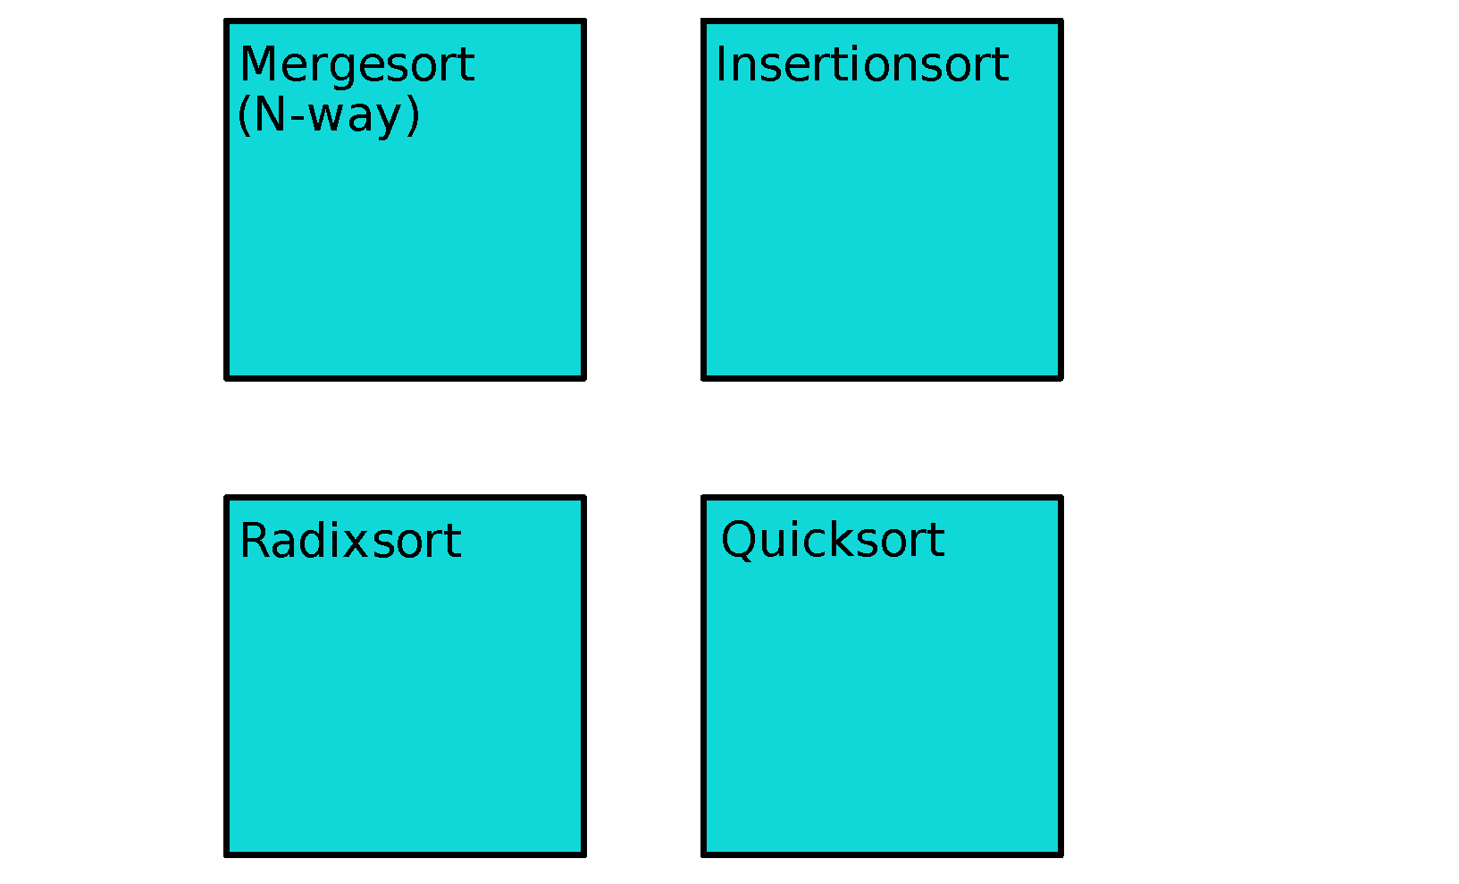
Algorithmic Choice in Sorting
Notes:
I’m going to begin with a motivating example. Consider the problem of sorting an array. There are lots of algorithms to do it, such as these four shown here.
The best choice of which algorithm to use depends on your machine, data type, and array size. Additionally, three of these choices are recursive, so these algorithms can call each other. So how do you decide what to use?

Slide 52
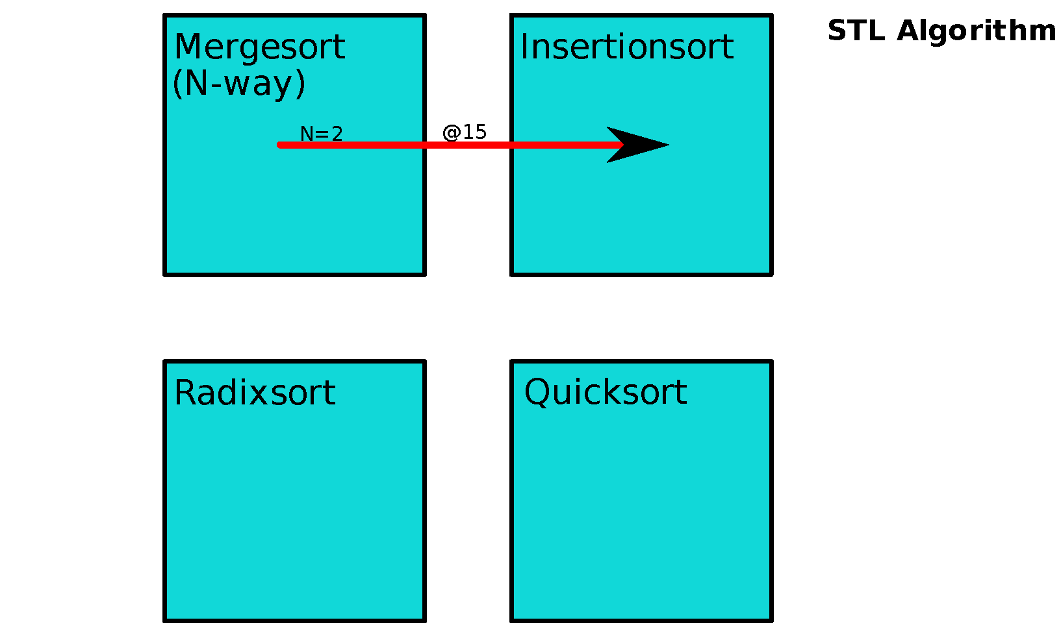
Algorithmic Choice in Sorting
Notes:
One choice is to pick a way and hard code it. For example, the C++ Standard Template Library recursively calls a 2-way merge sort until the array size is less than 16, at which point it switches to insertion sort.

Slide 53
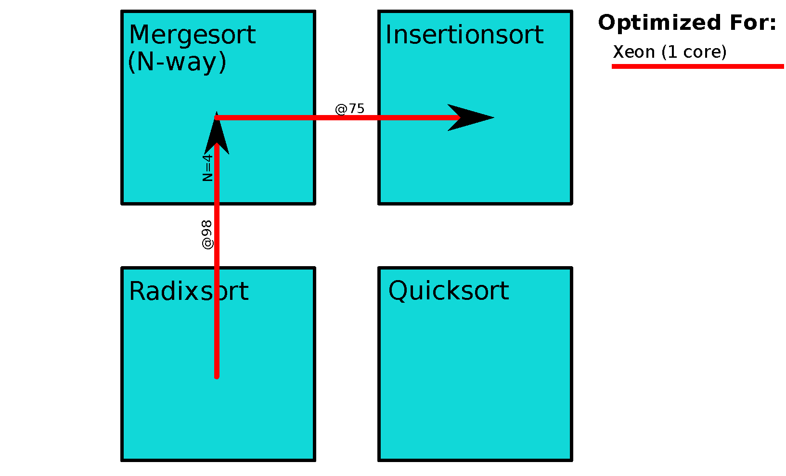
Algorithmic Choice in Sorting
Notes:
We found that when using a single core on a recent Xeon processor, it’s better to start with Radix Sort, switch to a 4-way Merge Sort, then Insertion Sort.

Slide 54
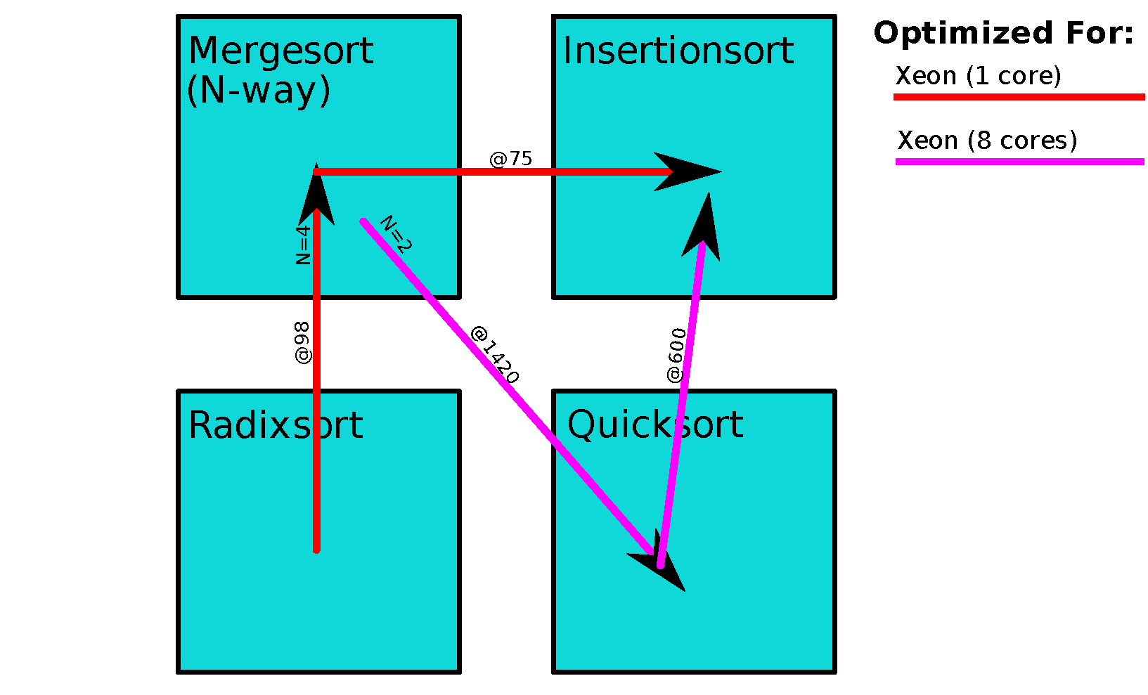
Algorithmic Choice in Sorting
Notes:
When we add parallelism using 8 cores, the best algorithm we found changed to using Merge Sort, then Quick Sort, then Insertion Sort.

Slide 55
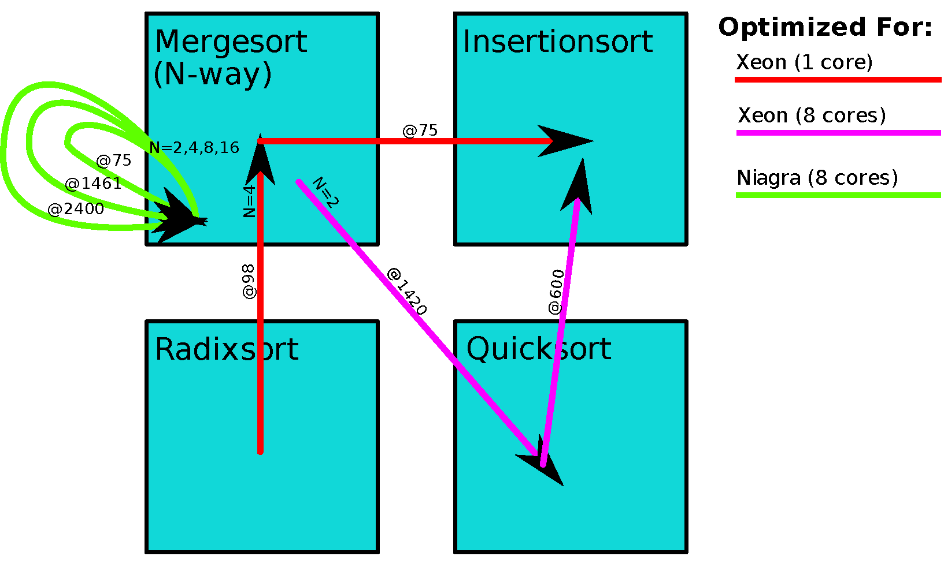
Algorithmic Choice in Sorting
Notes:
Now switching to a Sun Niagara, we found that sticking with Merge Sort, but changing the number of ways to merge was the fastest.
Clearly, we need a way to manage the problem of determining which algorithmic choices to make.

Slide 56
Future Proofing Sort
System |  | Cores used | Scalability | Algorithm Choices (w/ switching points)
Mobile | Core 2 Duo Mobile | 2 of 2 | 1.92 | IS(150) 8MS(600) 4MS(1295) 2MS(38400) QS(∞)
Xeon 1-way | Xeon E7340 (2 x 4 core) | 1 of 8 | - | IS(75) 4MS(98) RS(∞)
Xeon 8-way | Xeon E7340 (2 x 4 core) | 8 of 8 | 5.69 | IS(600) QS(1420) 2MS(∞)
Niagara | Sun Fire T200 | 8 of 8 | 7.79 | 16MS(75) 8MS(1461) 4MS(2400) 2MS(∞)

Slide 57
Future Proofing Sort
System |  | Cores used | Scalability | Algorithm Choices (w/ switching points)
Mobile | Core 2 Duo Mobile | 2 of 2 | 1.92 | IS(150) 8MS(600) 4MS(1295) 2MS(38400) QS(∞)
Xeon 1-way | Xeon E7340 (2 x 4 core) | 1 of 8 | - | IS(75) 4MS(98) RS(∞)
Xeon 8-way | Xeon E7340 (2 x 4 core) | 8 of 8 | 5.69 | IS(600) QS(1420) 2MS(∞)
Niagara | Sun Fire T200 | 8 of 8 | 7.79 | 16MS(75) 8MS(1461) 4MS(2400) 2MS(∞)
 |  | Trained On
 |  | Mobile | Xeon 1-way | Xeon 8-way | Niagara
Run On | Mobile | - | 1.09x | 1.67x | 1.47x
 | Xeon 1-way | 1.61x | - | 2.08x | 2.50x
 | Xeon 8-way | 1.59x | 2.14x | - | 2.35x
 | Niagara | 1.12x | 1.51x | 1.08x | -

Slide 58
Matrix Multiply
Time
Size

Slide 59
Matrix Multiply
Time
Size

Slide 60
Eigenvector Solve
Time
Size

Slide 61
Eigenvector Solve
Time
Size

Slide 62
Outline
The Three Side Stories
Performance and Parallelism with Multicores
Future Proofing Software
Evolution of Programming Languages
Three Observations
PetaBricks
Language
Compiler
Results
Variable Precision
Sibling Rivalry

Slide 63
Variable Accuracy Algorithms
Lots of algorithms where the accuracy of output can be tuned:
Iterative algorithms (e.g. solvers, optimization)
Signal processing (e.g. images, sound)
Approximation algorithms
Can trade accuracy for speed
All user wants: Solve to a certain accuracy as fast as possible using whatever algorithms necessary!
Notes:
In addition to contending with algorithmic choice, there are lots of algorithms where the accuracy of the output can be tuned.

Slide 64
A Very Brief Multigrid Intro
Used to iteratively solve PDEs over a gridded domain
Relaxations update points using neighboring values (stencil computations)
Restrictions and Interpolations compute new grid with coarser or finer discretization
Relax on current grid
Restrict to coarser grid
Interpolate to finer grid
Resolution
Compute Time
Notes:
So how do we apply this framework to multigrid? Not all of you may be familiar with multigrid, so here’s a very brief introduction.

Slide 65
Multigrid Cycles
How coarse do we go?
V-Cycle
W-Cycle
Relaxation operator?
How many iterations?
Full MG V-Cycle
Standard Approaches
Notes:
Here are some standard multigrid cycles
Lots of choices to make here: what relaxation operator to use, how many iterations? How coarse do we go?
Further, who’s to say we even need to pick one of these standard shapes?

Slide 66
Multigrid Cycles
Generalize the idea of what a multigrid cycle can look like
Example:
Goal: Auto-tune cycle shape for specific usage
relaxation
steps
direct or iterative shortcut
Notes:
You could also try taking shortcuts by solving directly or iteratively before reaching the coarsest level. How do you know which shape will work for best for your problem? It could be that something more complex would work really well for your particular problem.

Slide 67
Algorithmic Choice in Multigrid
Need framework to make fair comparisons
Perspective of a specific grid resolution
How to get from A to B?
A
B
A
B
Direct
Restrict
?
Interpolate
A
B
Recursive
Iterative

Slide 68
Algorithmic Choice in Multigrid
Tuning cycle shape!
Examples of recursive options:
A
B
Standard V-cycle

Slide 69
Algorithmic Choice in Multigrid
Tuning cycle shape!
Examples of recursive options:
A
B
A
B
Take a shortcut at a coarser resolution

Slide 70
Algorithmic Choice in Multigrid
Tuning cycle shape!
Examples of recursive options:
A
B
Iterating with shortcuts

Slide 71
Algorithmic Choice in Multigrid
Tuning cycle shape!
Once we pick a recursive option, how many times do we iterate?
Higher Accuracy
A
B
C
D
Number of iterations depends on what accuracy we want at the current grid resolution!

Slide 72
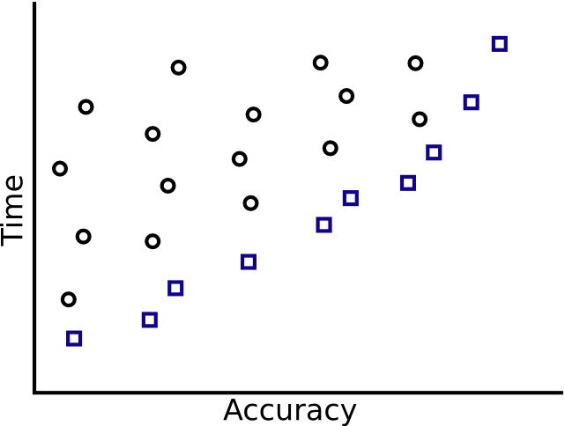
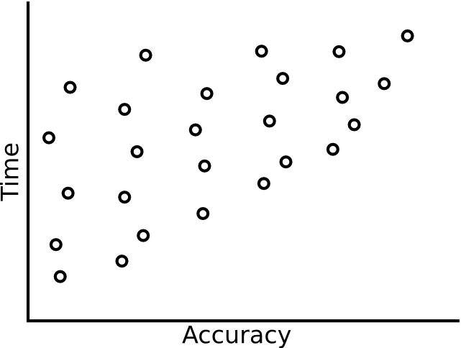
Optimal Subproblems
Plot all cycle shapes for a given grid resolution:
Idea: Maintain a family of optimal algorithms for each grid resolution
Keep only the
optimal ones!
Better

Slide 73
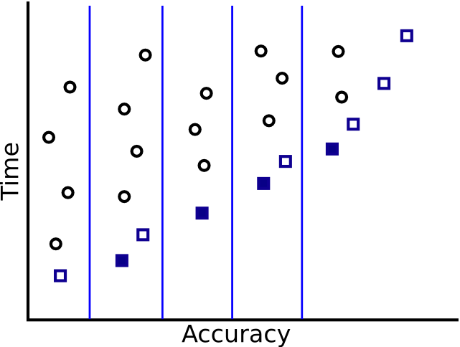
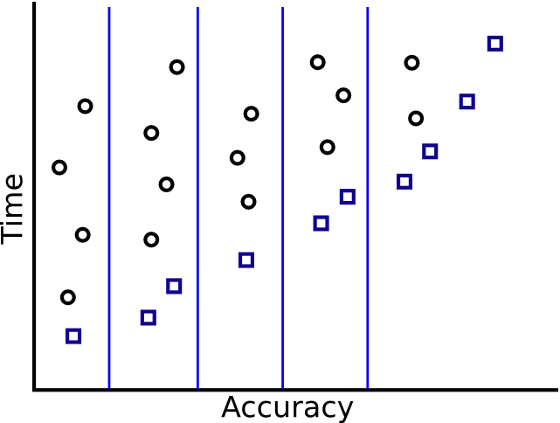
The Discrete Solution
Problem: Too many optimal cycle shapes to remember
Solution: Remember the fastest algorithms for a discrete set of accuracies
Remember!

Slide 74
Use Dynamic Programming to Manage Auto-tuning Search
Only search cycle shapes that utilize optimized sub-cycles in recursive calls
Build optimized algorithms from the bottom up
Allow shortcuts to stop recursion early
Allow multiple iterations of sub-cycles to explore time vs. accuracy space

Slide 75
Auto-tuning the V-cycle
transform Multigrid_{k}
from X[n,n], B[n,n]
to Y[n,n]
{
// Base case
// Direct solve
OR
// Base case
// Iterative solve at current resolution
OR
// Recursive case
// For some number of iterations
// Relax
// Compute residual and restrict
// Call Multigrid_{i} for some i
// Interpolate and correct
// Relax
}
Algorithmic choice
Shortcut base cases
Recursively call some optimized sub-cycle
Iterations and recursive accuracy let us explore accuracy versus performance space
Only remember “best” versions
?

Slide 76
Variable Accuracy Keywords
accuracy_variable – tunable variable
accuracy_metric – returns accuracy of output
accuracy_bins – set of discrete accuracy bins
generator – creates random inputs for accuracy measurement
transform Multigrid_{k}
from X[n,n], B[n,n]
to Y[n,n]
accuracy_variable numIterations
accuracy_metric Poisson2D_metric
accuracy_bins 1e1 1e3 1e5 1e7
generator Poisson2D_Generator
{
…

Slide 77
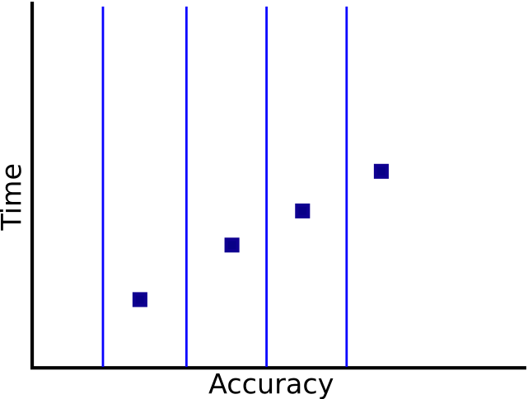
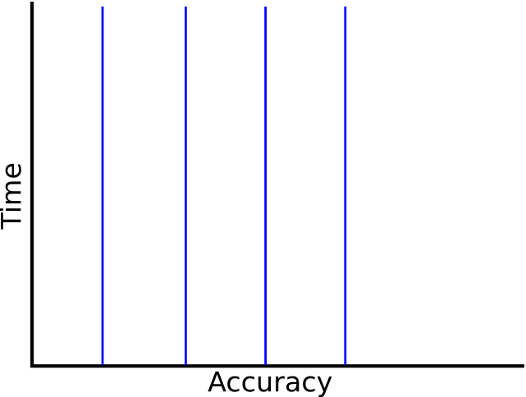
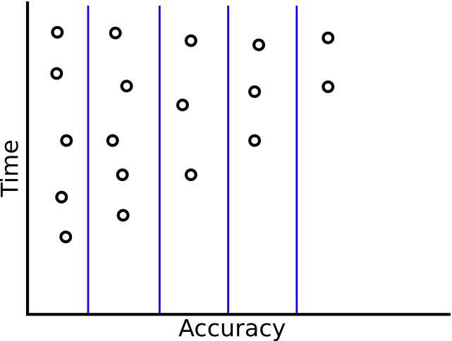
Training the Discrete Solution
Resolution i
Resolution i+1
Accuracy 1
Accuracy 2
Accuracy 3
Accuracy 4
Resolution
i+1
Multigrid
Algorithm
Multigrid
Algorithm
Multigrid
Algorithm
Multigrid
Algorithm
Training
Resolution
i
Multigrid
Algorithm
Multigrid
Algorithm
Multigrid
Algorithm
Multigrid
Algorithm
Optimized

Slide 78
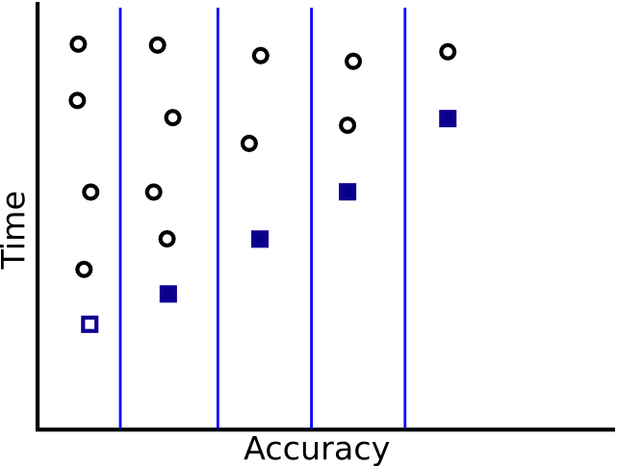
Training the Discrete Solution
Resolution i
Resolution i+1
Accuracy 1
Accuracy 2
Accuracy 3
Accuracy 4
Resolution
i+1
Multigrid
Algorithm
Multigrid
Algorithm
Multigrid
Algorithm
Multigrid
Algorithm
Optimized
Resolution
i
Multigrid
Algorithm
Multigrid
Algorithm
Multigrid
Algorithm
Multigrid
Algorithm
Optimized

Slide 79
Training the Discrete Solution
Accuracy 1
Accuracy 2
Accuracy 3
Accuracy 4
Finer
Multigrid
Algorithm
Multigrid
Algorithm
Multigrid
Algorithm
Multigrid
Algorithm
Multigrid
Algorithm
Multigrid
Algorithm
Multigrid
Algorithm
Multigrid
Algorithm
Optimized
Training
1x
Multigrid
Algorithm
Multigrid
Algorithm
Multigrid
Algorithm
Multigrid
Algorithm
Multigrid
Algorithm
Multigrid
Algorithm
Multigrid
Algorithm
Multigrid
Algorithm
Training
Optimized
2x
Multigrid
Algorithm
Multigrid
Algorithm
Multigrid
Algorithm
Multigrid
Algorithm
Coarser
Optimized
Tuning order
Possible choice
(Shortcuts not shown)

Slide 80
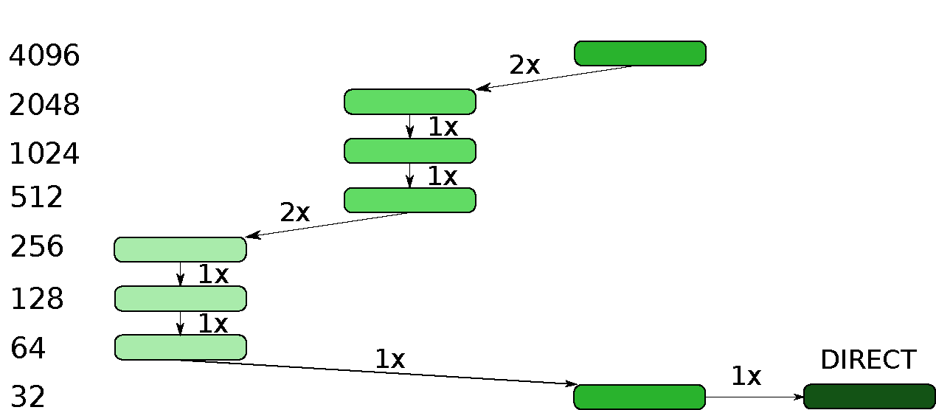
Example: Auto-tuned 2D Poisson’s Equation Solver
Accy. 10
Accy. 10³
Accy. 10⁷
Finer
Coarser

Slide 81
Auto-tuned Cycles for 2D Poisson Solver
Cycle shapes for accuracy levels a) 10, b) 10³, c) 10⁵, d) 10⁷
Optimized substructures visible in cycle shapes

Slide 82
Poisson
Time
Matrix Size

Slide 83
Poisson
Time
Matrix Size

Slide 84
Binpacking – Algorithmic Choices
Data Size
Accuracy

Slide 85
Outline
The Three Side Stories
Performance and Parallelism with Multicores
Future Proofing Software
Evolution of Programming Languages
Three Observations
PetaBricks
Language
Compiler
Results
Variable Precision
Sibling Rivalry

Slide 86
Issues with Offline Tuning
Offline-tuning workflow burdensome
Programs often not re-autotuned when they should be
e.g. apt-get install fftw does not re-autotune
Hardware upgrades / large deployments
Transparent migration in the cloud
Can't adapt to dynamic conditions
System load
Input types

Slide 87
SiblingRivalry: an Online Approach
Split available resources in half
Process identical requests on both halves
Race two candidate configurations (safe and experimental) and terminate slower algorithm
Initial slowdown (from duplicating the request) can be overcome by autotuner
Surprisingly, reduces average power consumption per request

Slide 88
Experimental Setup

Slide 89
SiblingRivalry: throughput

Slide 90
SiblingRivalry: energy usage (on AMD48)

Slide 91
Conclusion
Time has come for languages based on autotuning
Convergence of multiple forces
The Multicore Menace
Future proofing when machine models are changing
Use more muscle (compute cycles) than brain (human cycles)
PetaBricks – We showed that it can be done!
Will programmers accept this model?
A little more work now to save a lot later
Complexities in testing, verification and validation

