Slide 1
Erkang Zheng Introduction
Founder & CEO, JupiterOne

Slide 2
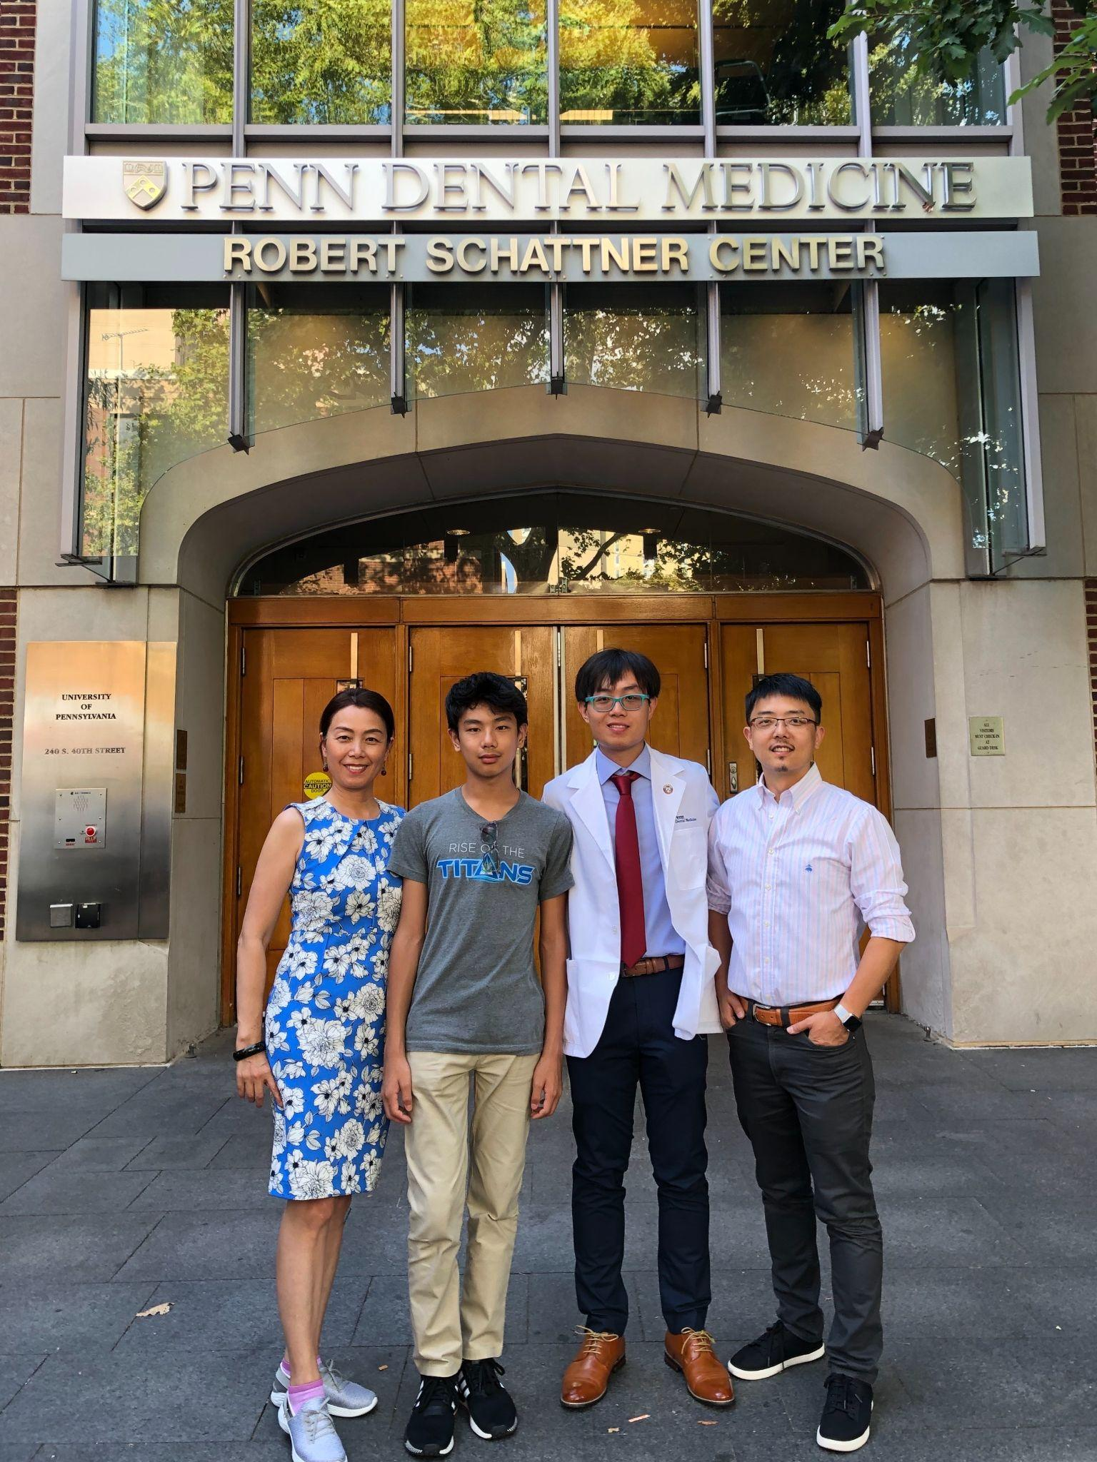
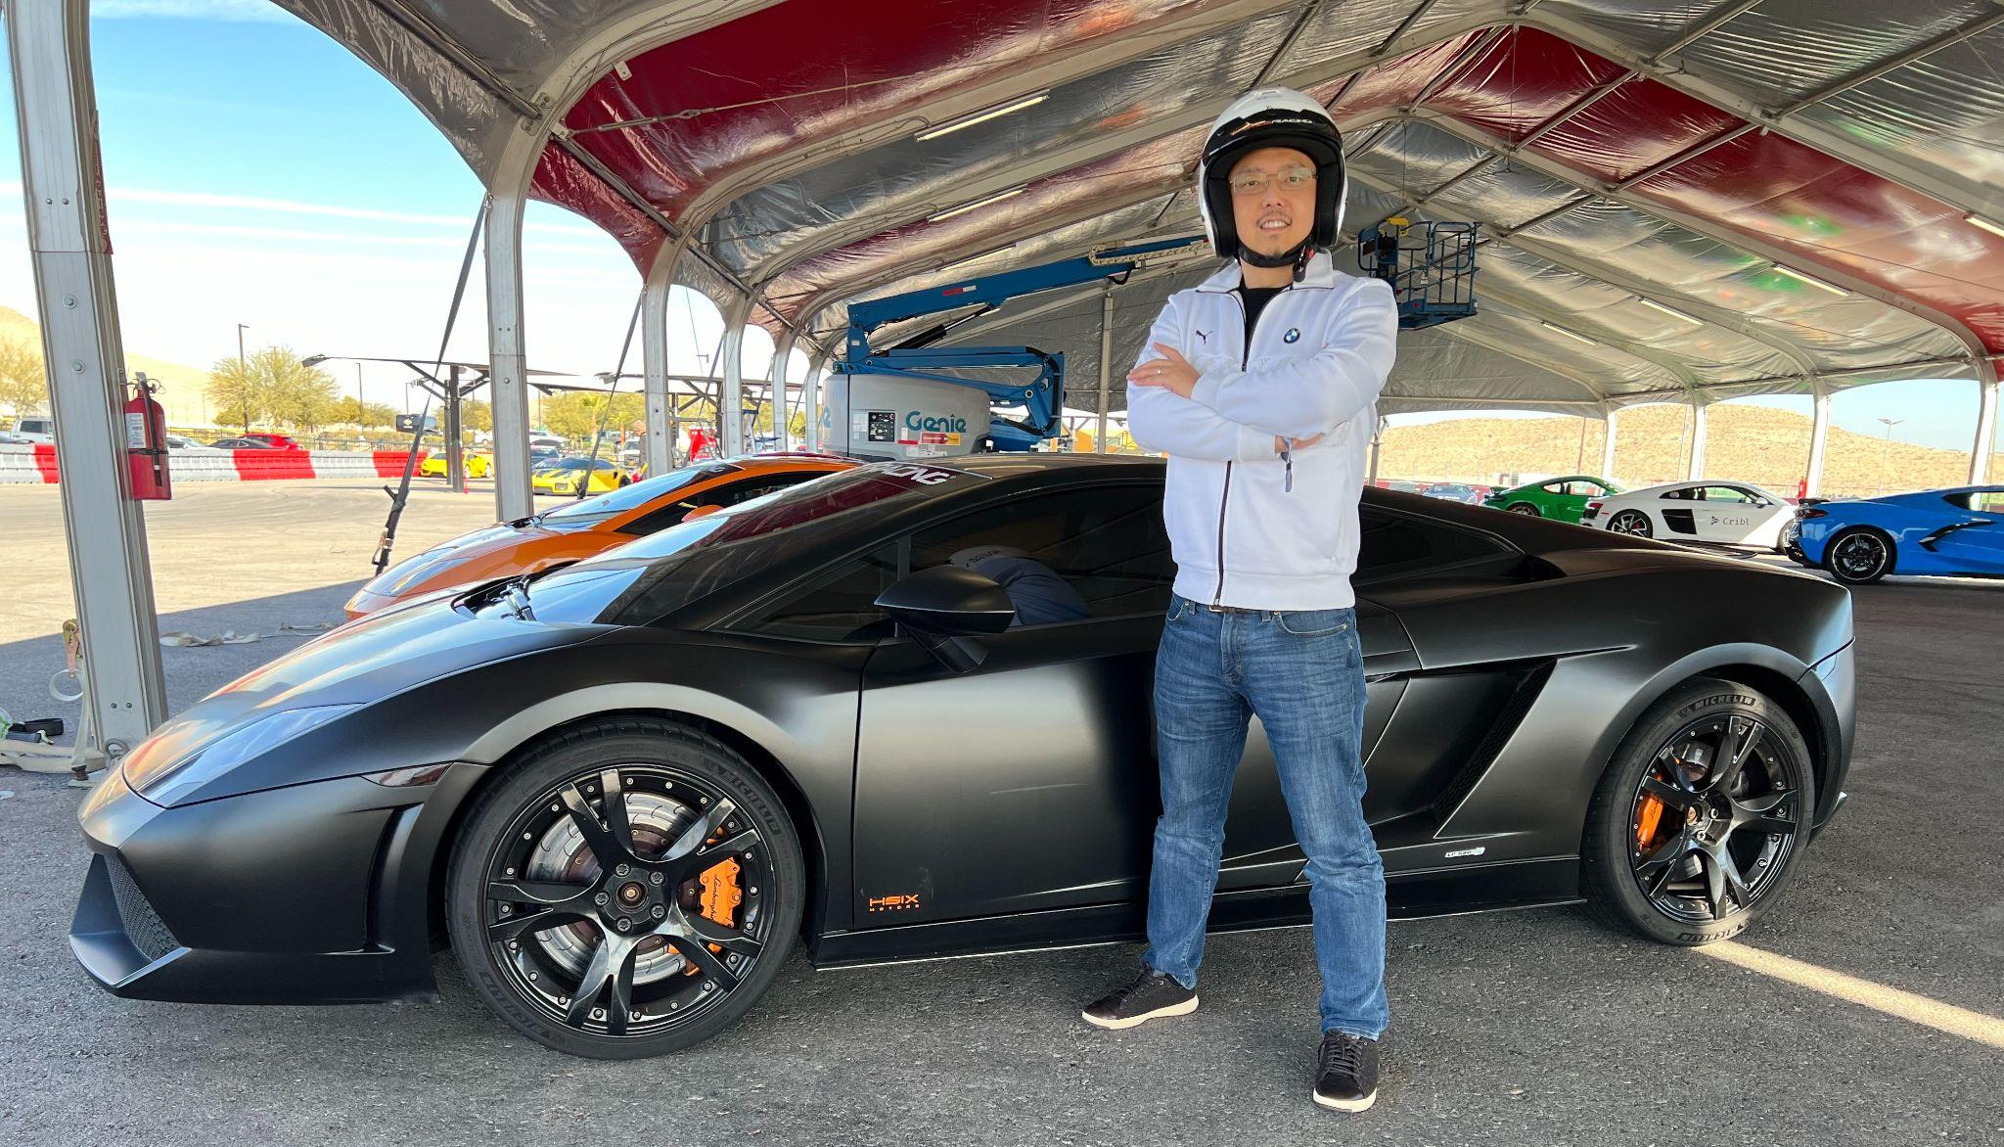
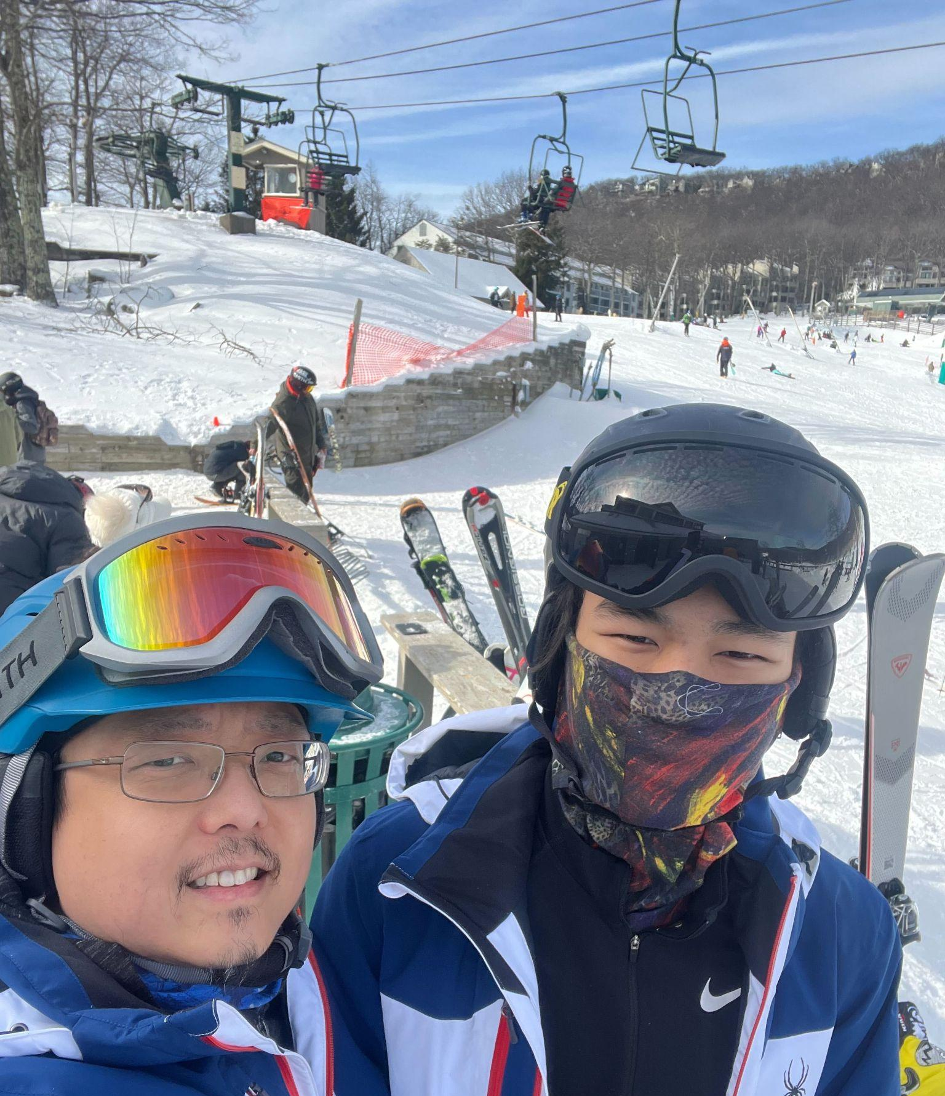
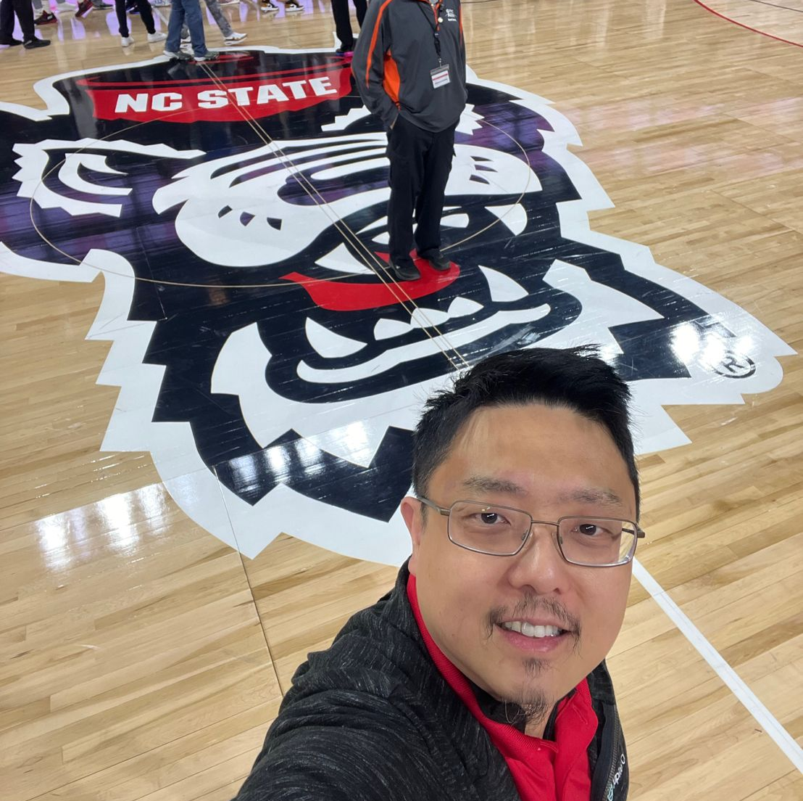
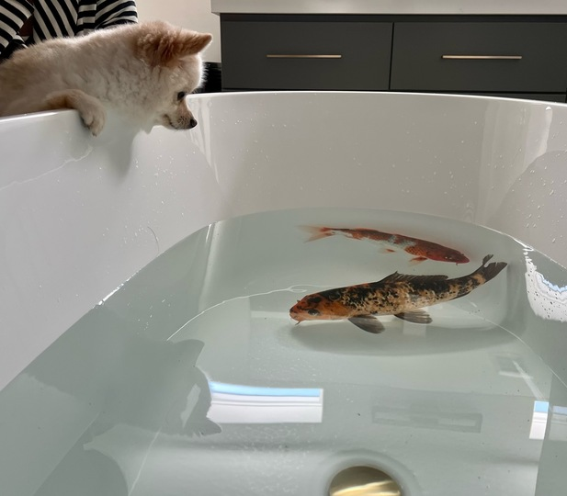
Personal
Born in Beijing, China
Grew up in Guangzhou, China
Currently reside in Cary, NC -- been in NC since 2000
B.S. and M.S., Computer Science, NCSU
Married with family
Hobbies & interests: Deep-sea fishing, skiing, fast cars, tropical fish

Slide 3
Professional
Cisco - Principal Engineer and QA Lead
IMAR - CIO
Stonewall Networks - Chief Security Architect
Refense Technologies - CTO
P4 Performance Management - CTO
Magnus Health - CTO
IBM - Security practitioner and global practices leader
Fidelity - Head of Software Security
LifeOmic - CISO
JupiterOne - CEO & Founder

Slide 4
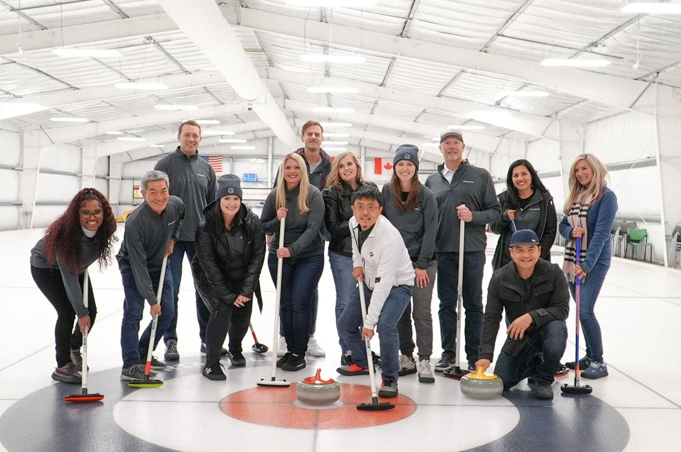
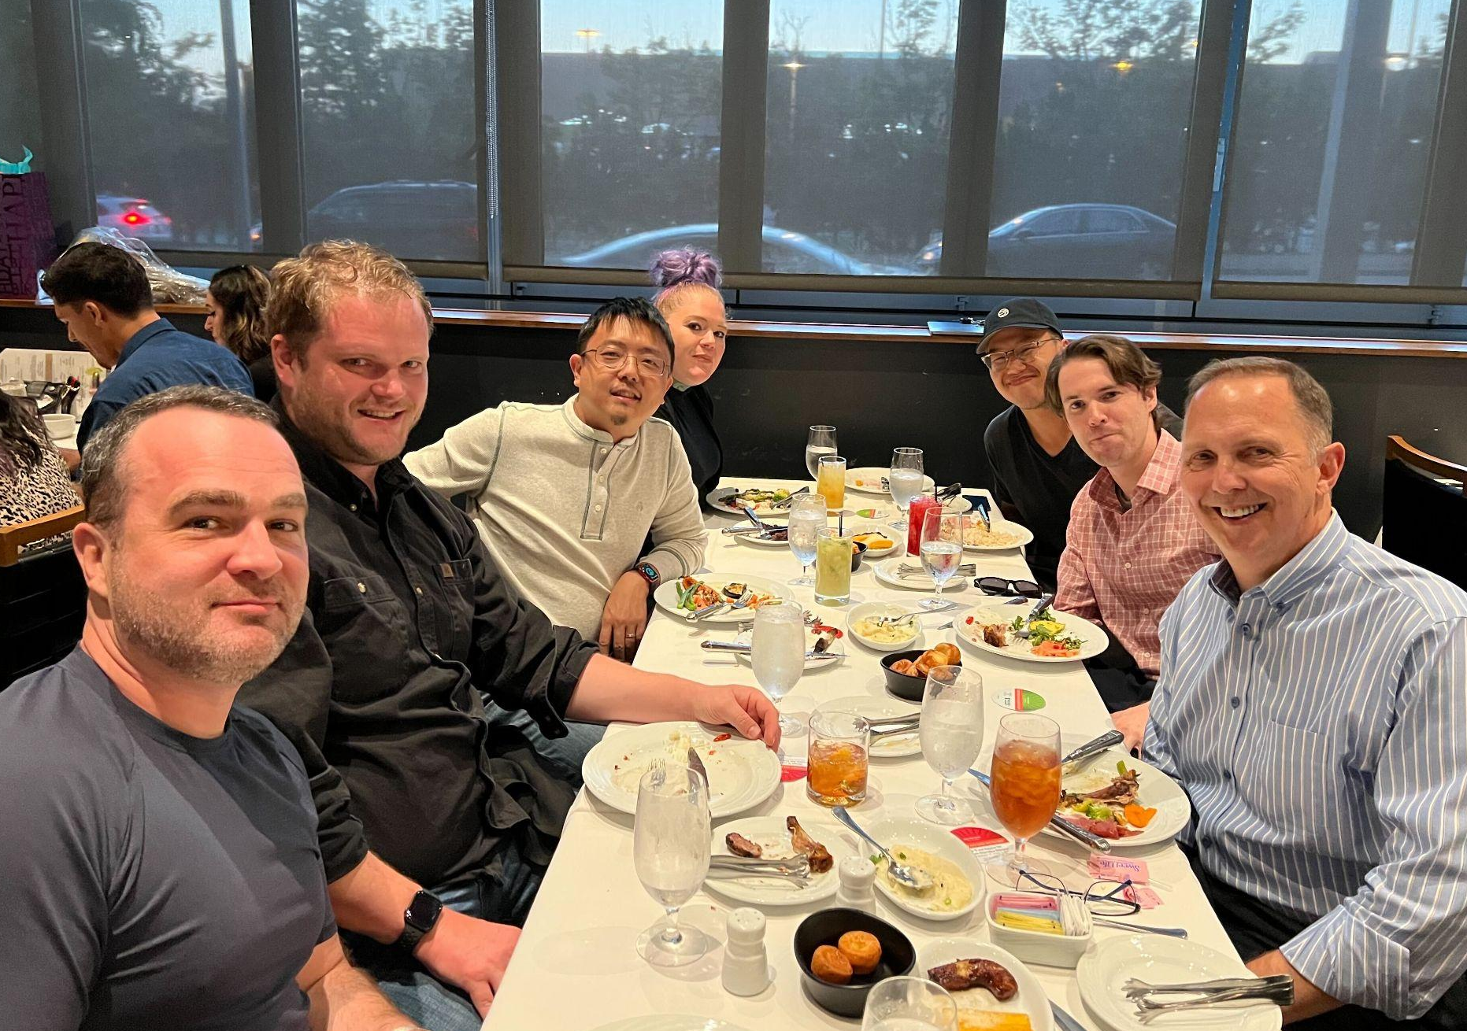
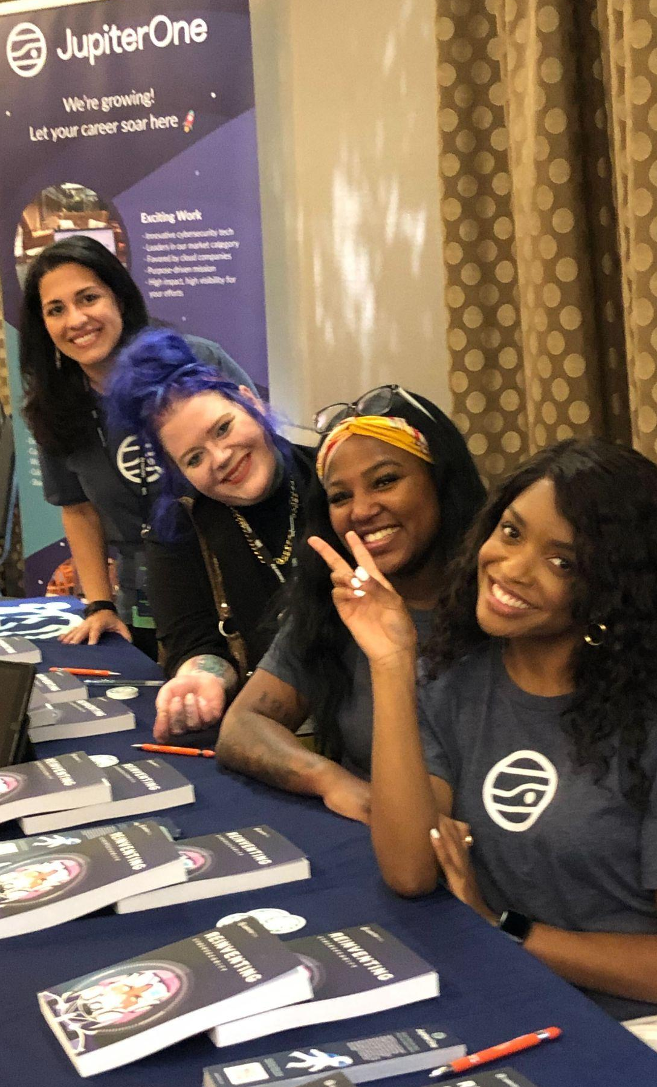
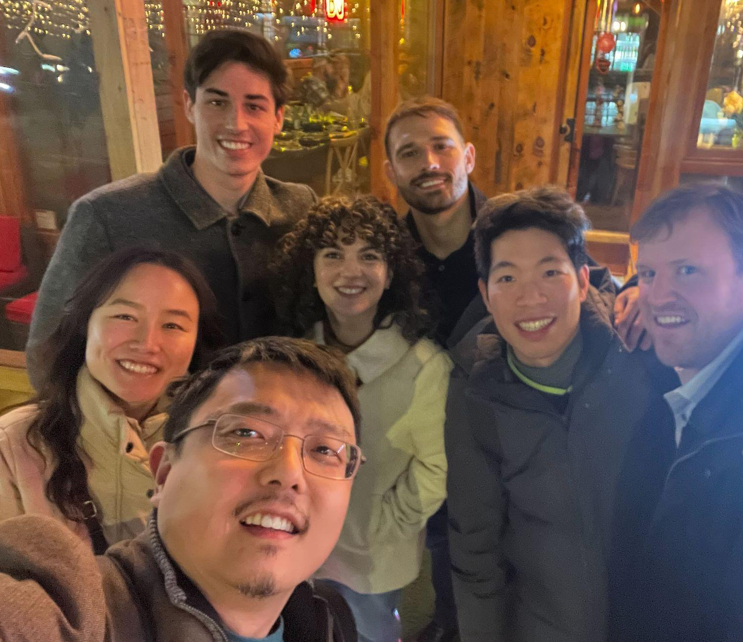
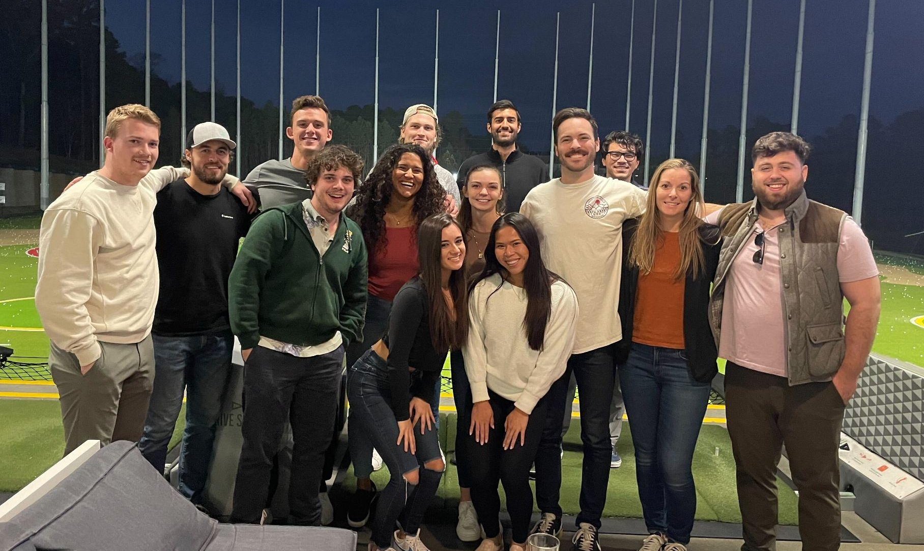
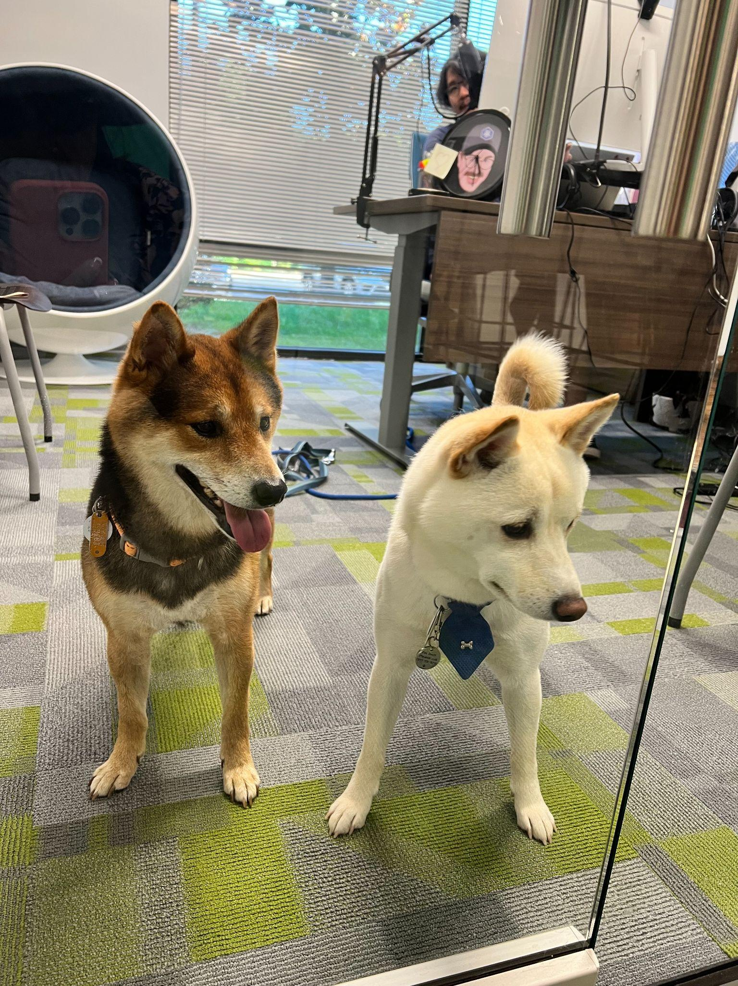
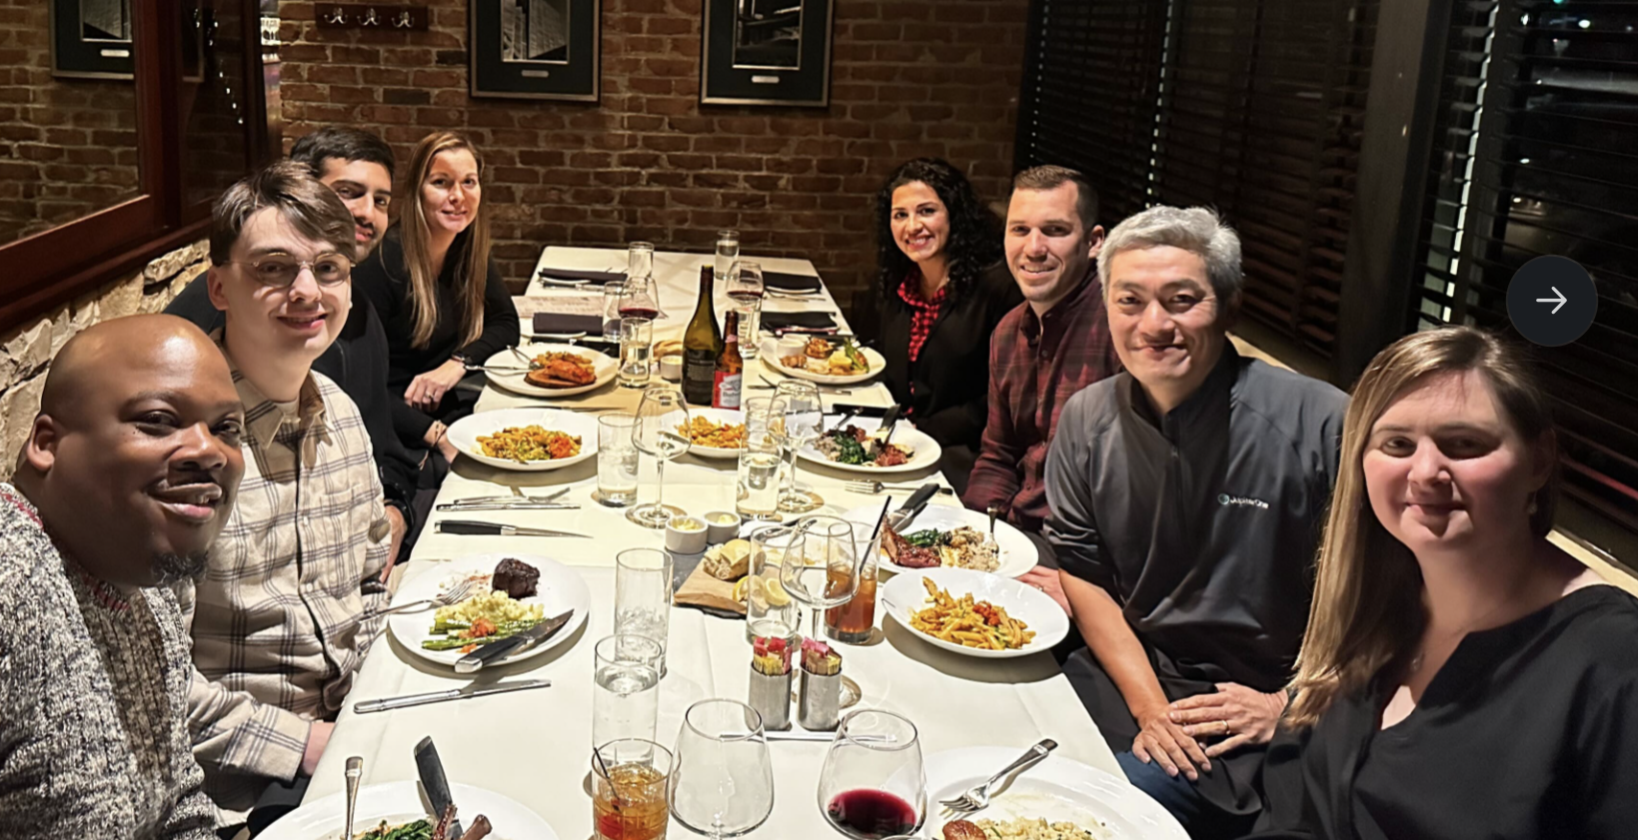
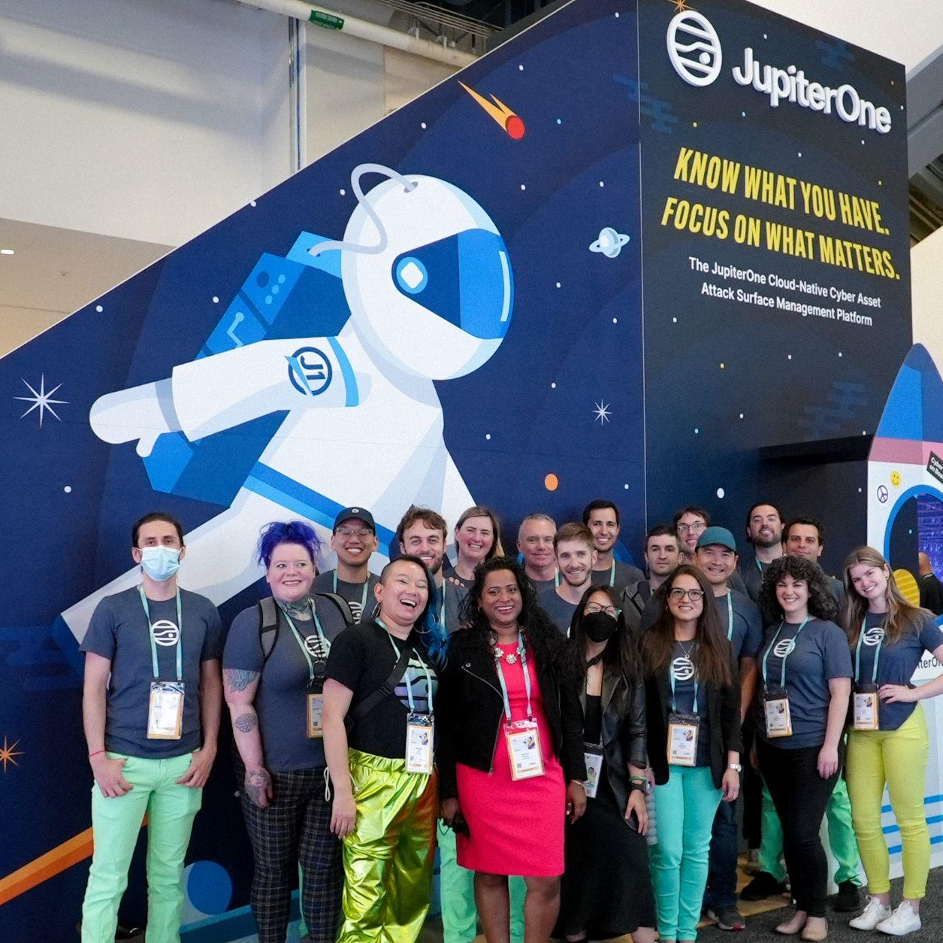
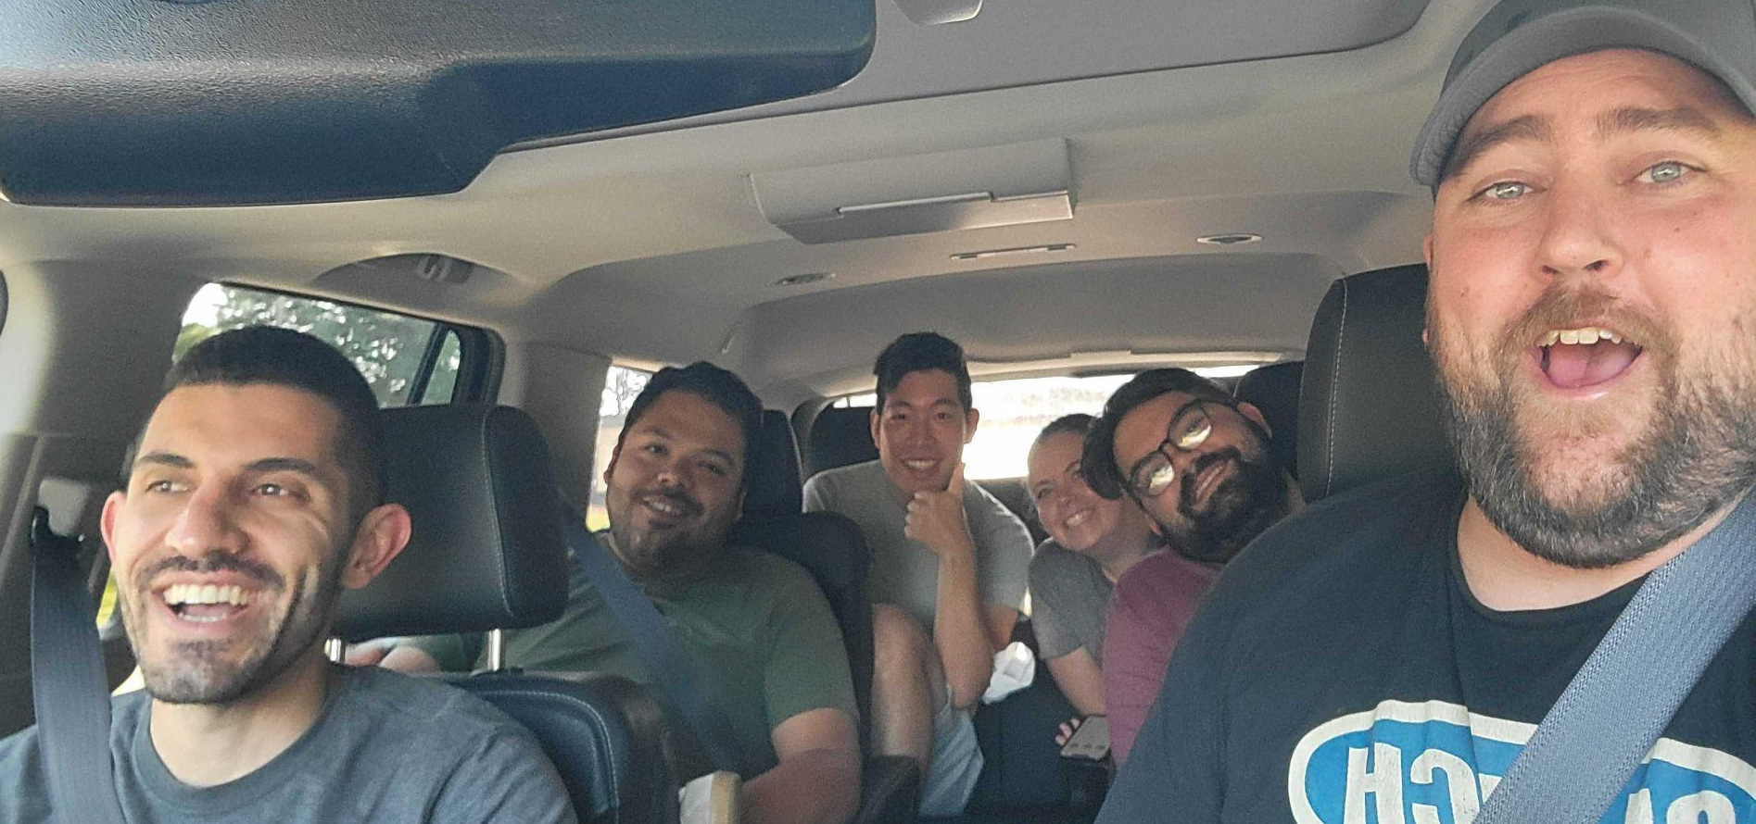
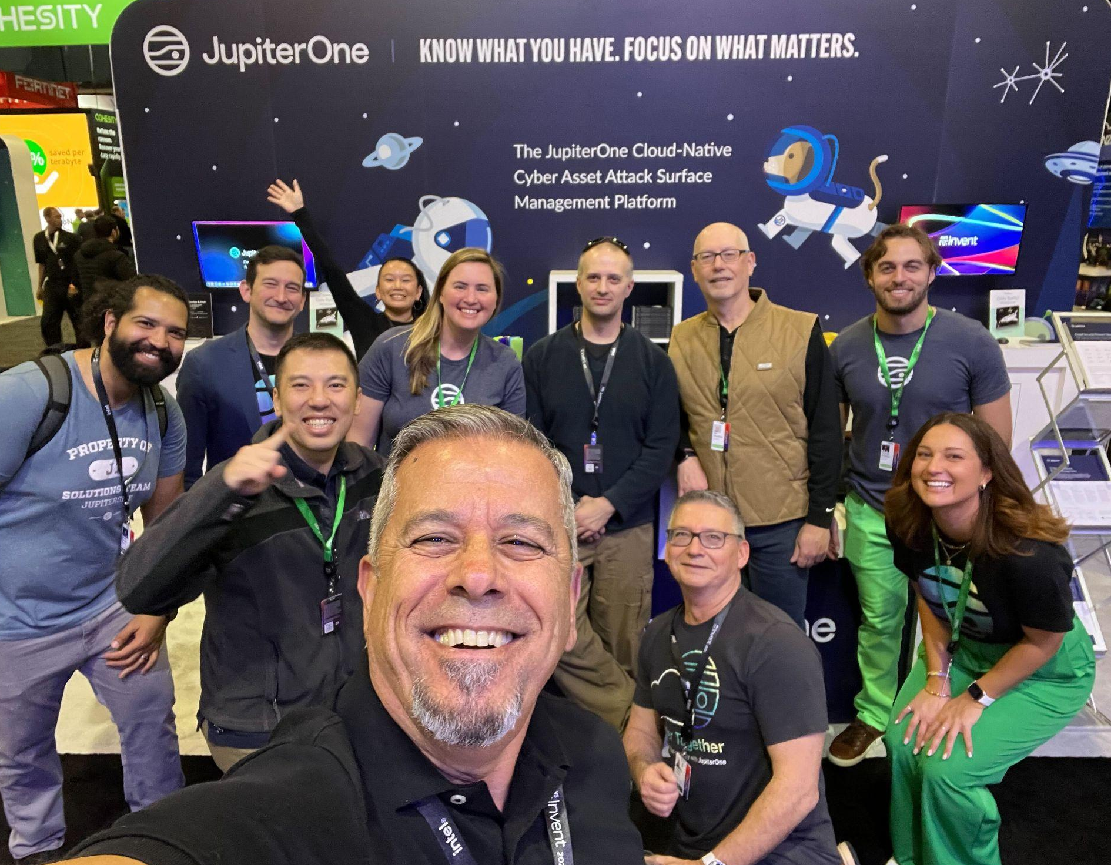
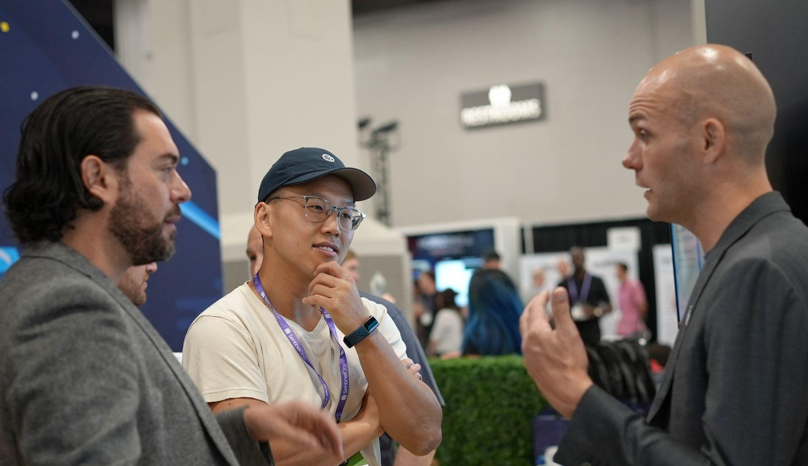
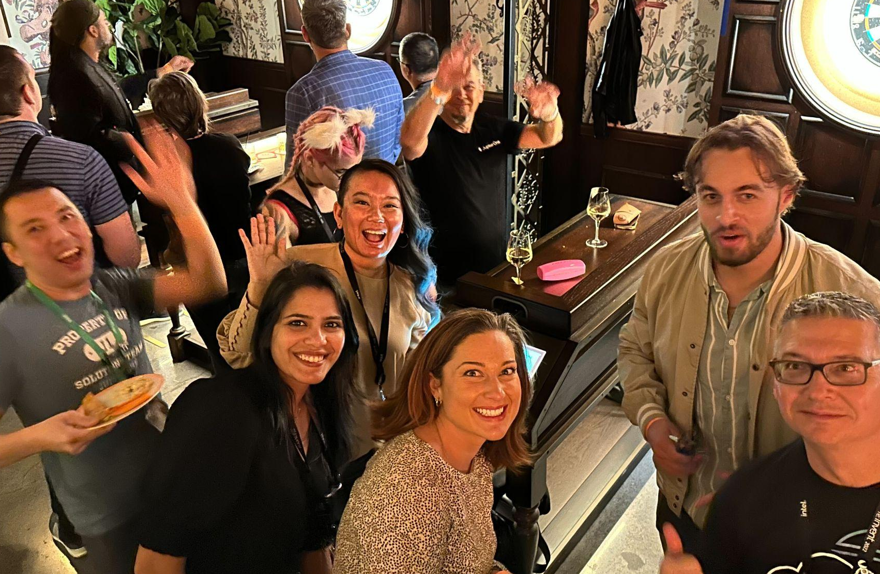
One Team, Unified.

